Slide 1


Sessions 1 and 2: Basic business equation or balance sheet as an equation
Financial Analysis
BBA FinTech, 2nd year
Eric Maton

Slide 2
Sessions 1 and 2
Basic business equation or fundamental accounting equation (balance sheet represented as an equation)
Sessions 3 and 4
Income statement (or P&L: profit and loss account): from accounting information to financial analysis
Brief contents
Session 5 and 6
Non-current assets (P,P&E, intangible assets and right-of-use assets) and current assets (inventories)

Slide 3
Session 7
Financial analysis techniques:
Activity ratios, solvency ratios and liquidity ratios
Brief contents
Sessions 8 and 9
Statement of cash flows (operating cash flows, investing cash flows and financing cash flows) and revision

Slide 4
Grade
10% Midterm exam 1: MCQ on Blackboard at the beginning of session 4 (Tuesday 24 March) (30 minutes) with simple calculator
20% Midterm exam 2: MCQ on Blackboard at the beginning of session 7 (Tuesday 31 March) (1 hour) with simple calculator
10% Attendance
60% Final examination: 3 exercises (2 hours)

Slide 5
Basic business equation or balance sheet as an equation

Slide 6
Balance sheet (BS) represented as an equation
Assets (A)
=
Liabilities (L)
+
Equity (E)
What the company owns
(and sometimes what you use: leases can be included according to accounting system)
How the company finances the counterpart (assets)
Stakeholders
(excluding shareholders)
Shareholders
6

Slide 7
Assets at net value = Liabilities + Equity
Balance sheet (BS) represented as an equation
Assets (A)
=
Liabilities (L)
+
Equity (E)
What the company owns at net value
(means after all the reductions in value: accumulated depreciation, amortization, impairment losses, write-down of inventories, allowance for doubtful accounts)
Because of the reduction of value of assets we have a wealth reduction for shareholders
New reduction in value = noncash expense
7

Slide 8
Usage (or consumption) = expense (income statement) = reduction in equity (and reduction in assets at net value) Example: depreciation and amortization expense
Property, plant and equipment (P,P&E) (or tangible fixed assets): New equipment acquired at RMD400,000 (acquisition cost) on January 1st, 2025
Starting date to use the equipment: January 1st, 2025
Payment date: March 1st, 2025
Depreciation method: straight-line method
Useful life: 5 years
Residual (or salvage) value: RMD 50,000
What is the 2025 depreciation expense?

Slide 9
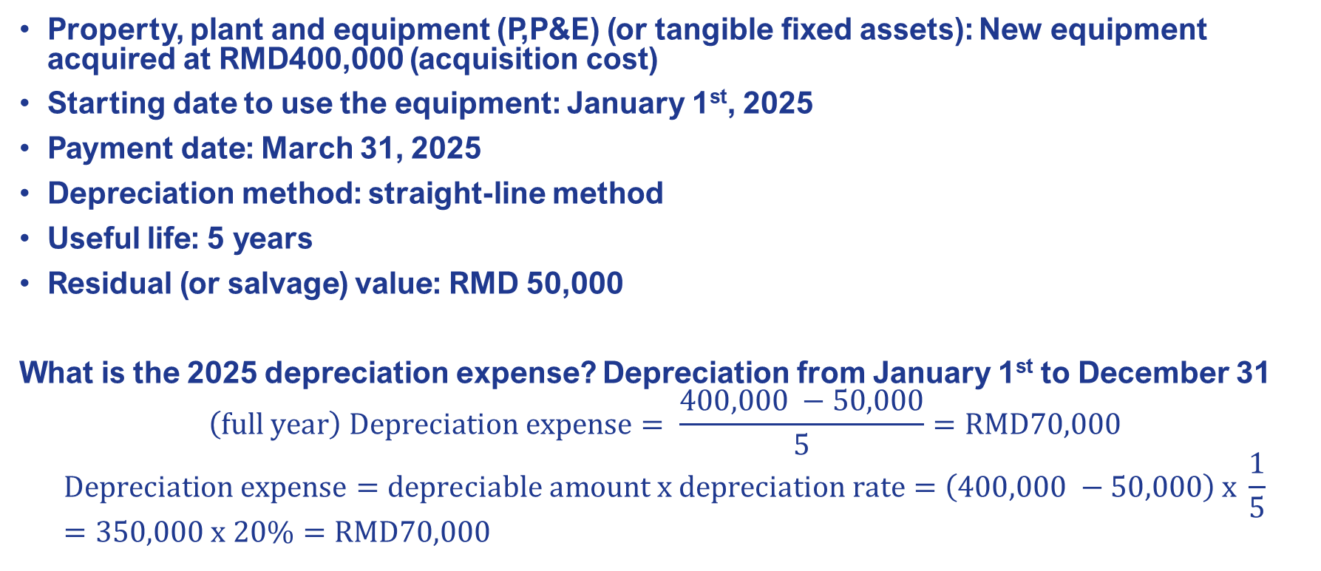
Usage (or consumption) = expense (income statement) = reduction in equity (and reduction in assets at net value) Example: depreciation and amortization expense
Property, plant and equipment (P,P&E) (or tangible fixed assets): New equipment acquired at RMD400,000 (acquisition cost)
Starting date to use the equipment: January 1st, 2025
Payment date: March 31, 2025
Depreciation method: straight-line method
Useful life: 5 years
Residual (or salvage) value: RMD 50,000
What is the 2025 depreciation expense? Depreciation from January 1st to December 31
$$\left(full year\right) Depreciation expense= \frac{400,000 −50,000}{5}=RMD70,000$$
$$Depreciation expense=depreciable amount x depreciation rate=\left(400,000 −50,000\right) x \frac{1}{5}=350,000 x 20\%=RMD70,000$$

Slide 10
Equipment effects on balance sheet
Closing date: December 31
Change in: | Current assets | Non-current assets | Current liabilities | Non-current liabilities | Equity
Equipment acquisition on credit (January 1st)
Equipment payment (March 31)
Decembre 31 (cut off)

Slide 11
Equipment effects on balance sheet
Closing date: December 31
Change in: | Current assets | Non-current assets | Current liabilities | Non-current liabilities | Equity
Equipment acquisition on credit (January 1st) |  | Equipment: RMD400,000 | Accounts payable (suppliers of equipment): RMD400,000
Equipment payment (March 31) | Cash and cash equivalents: RMD(400,000) |  | Accounts payable (suppliers of equipment): RMD(400,000)
Decembre 31 (cut off) |  | Accumulated depreciation: RMD(70,000) |  |  | Depreciation expense RMD (70,000)

Slide 12
Equipment effects on balance sheet
Closing date: December 31
Change in: | Current assets | Non-current assets | Current liabilities | Non-current liabilities | Equity
Equipment acquisition on credit (January 1st) |  | Equipment: RMD400,000 | Accounts payable (suppliers of equipment): RMD400,000
Equipment payment (March 31) | Cash and cash equivalents: RMD(400,000) |  | Accounts payable (suppliers of equipment): RMD(400,000)
Decembre 31 (cut off) |  | Accumulated depreciation: RMD(70,000) |  |  | Depreciation expense RMD (70,000)
Cash effect
Effect on income statement

Slide 13
Equipment effects on balance sheet
Change in: | Current assets | Non-current assets | Current liabilities | Non-current liabilities | Equity
Equipment acquisition on credit (January 1st) |  | Equipment: RMD400,000 | Accounts payable (suppliers of equipment): RMD400,000
Equipment payment (March 31) | Cash and cash equivalents: RMD(400,000) |  | Accounts payable (suppliers of equipment): RMD(400,000)
Decembre 31 (cut off) |  | Accumulated depreciation: RMD(70,000) |  |  | Depreciation expense RMD (70,000)
Total effects (in 2025) | (400,000) Reduction in cash and cash equivalents | 330,000 Equipment at net value | 0 | 0 | (70,000) Depreciation expense (income statement)

Slide 14
Basic business equation: all is included in the balance sheet
Balance sheet (BS) represented as an equation
In red: financial statements
Cash and cash equivalents, retained earnings, accumulated OCI (other comprehensive income): line items in balance sheet
Assets (A)
=
Liabilities (L)
+
Equity (E)
Cash and cash equivalents
Accumulated OCI
Retained earnings
Statement of change in equity
Statement of cash flows
Statement of comprehensive income
Income statement
(or P&L)
14
All the financial statements in one.

Slide 15
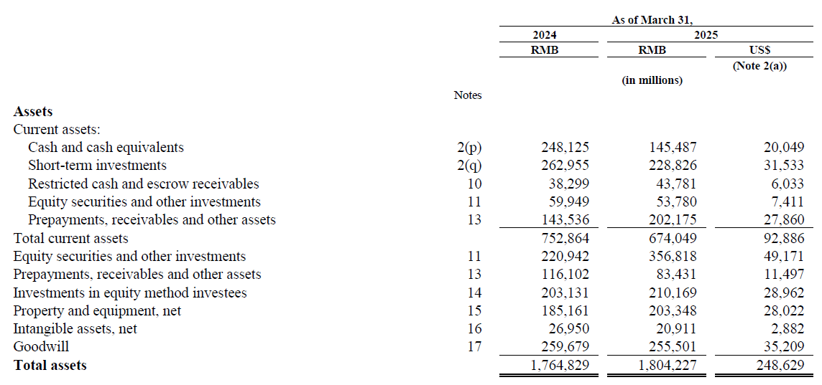
Alibaba
Current assets (short-term assets)
+
Non-current assets (long-term assets)
Long-term-term: more than 1 year

Slide 16
Alibaba
“Cash and cash equivalents”: the bottom line in the statement of cash flows
(in Alibaba statement of cash flows “restricted cash and escrow receivables” are also included)
Long-term-term: more than 1 year

Slide 17
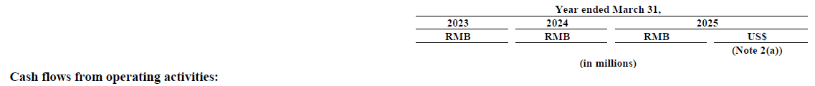
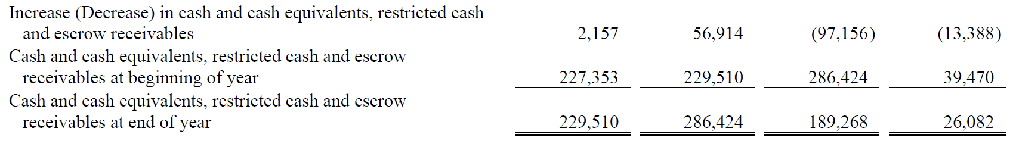
Alibaba
+
+
+
=

Slide 18
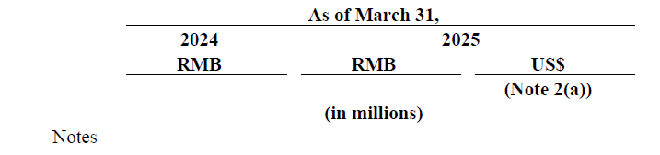
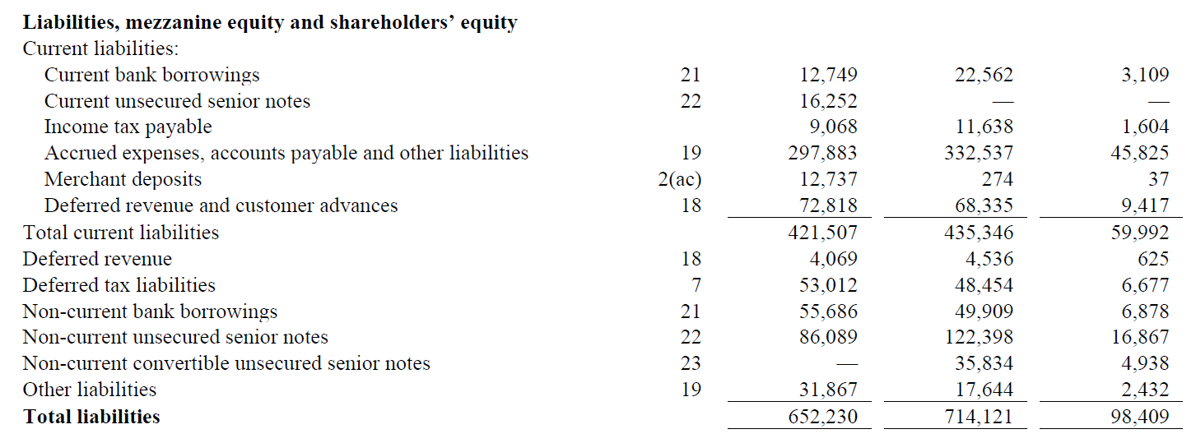
Alibaba
Current liabilities (short-term financing)
+
Non-current liabilities (long-term financing)

Slide 19
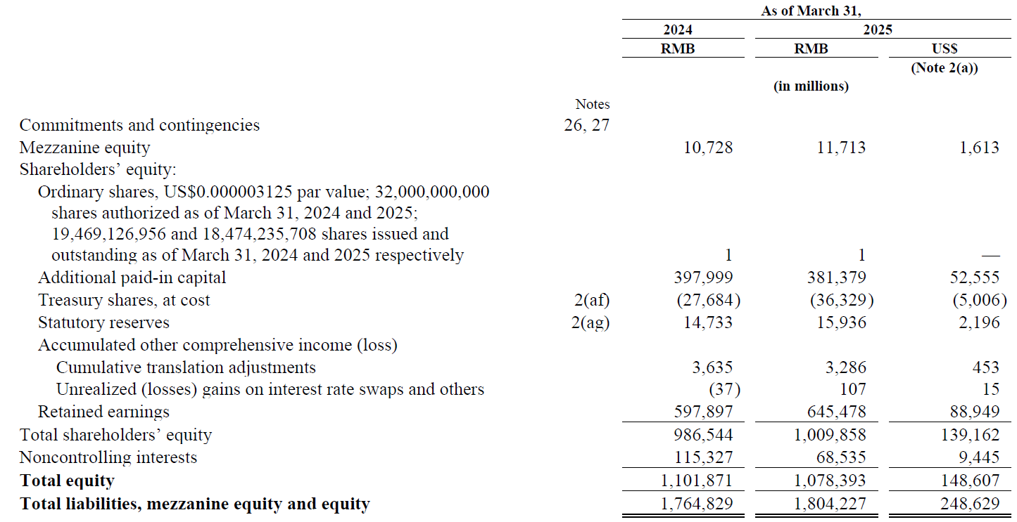
Alibaba
Shareholders’ Equity (long-term financing)
Net income of the period is included here

Slide 20
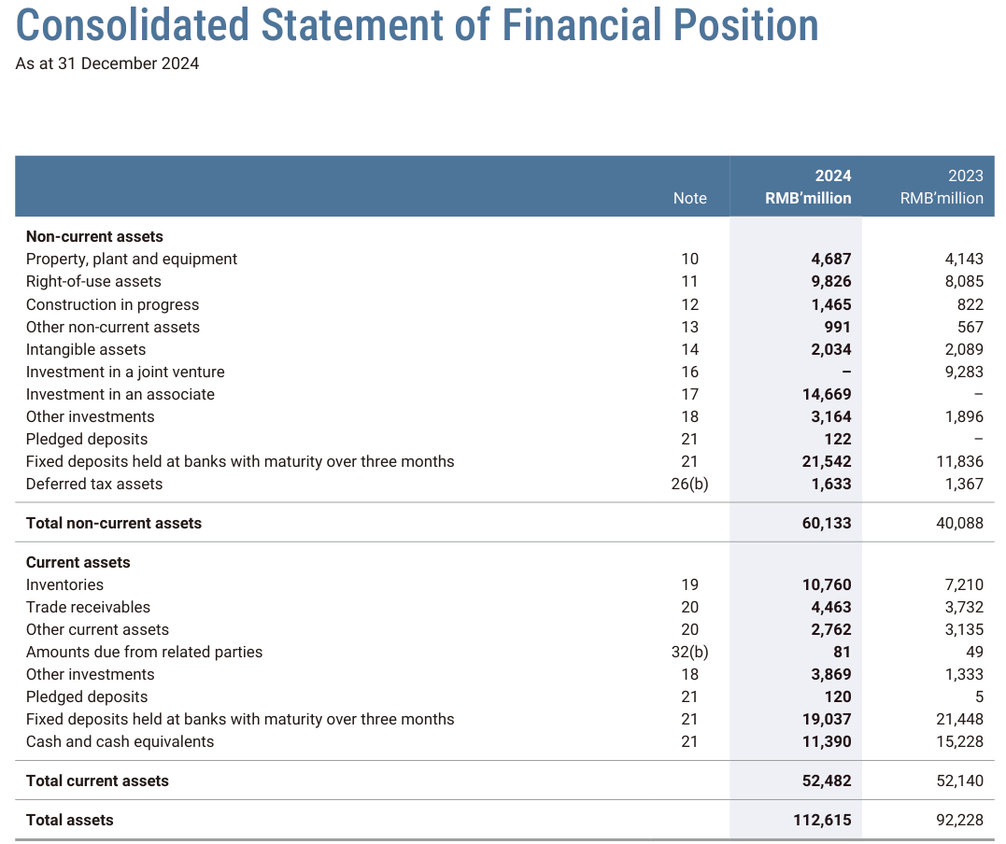
Anta Sports
Non-current assets
+
Current assets

Slide 21
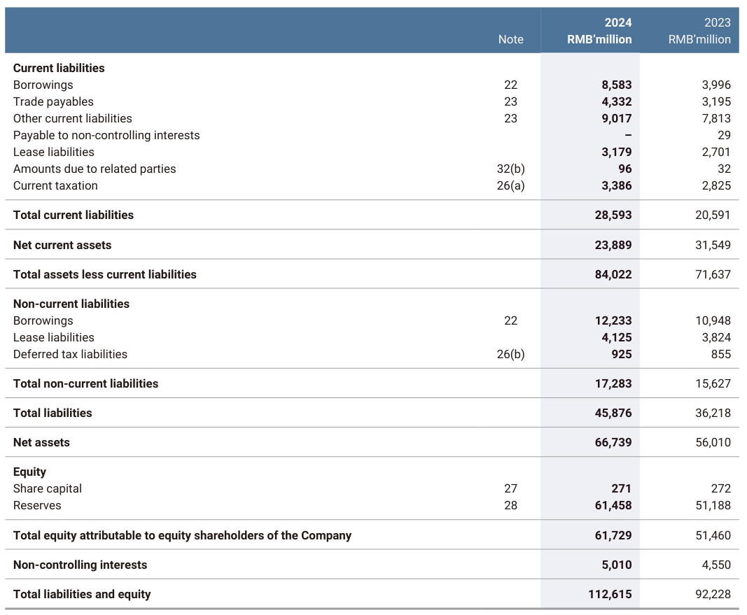
Anta Sports
Current assets
–
Current liabilities
=
Working capital (or “net current assets”)
Assets – Liabilities = Net assets
=
Equity

Slide 22
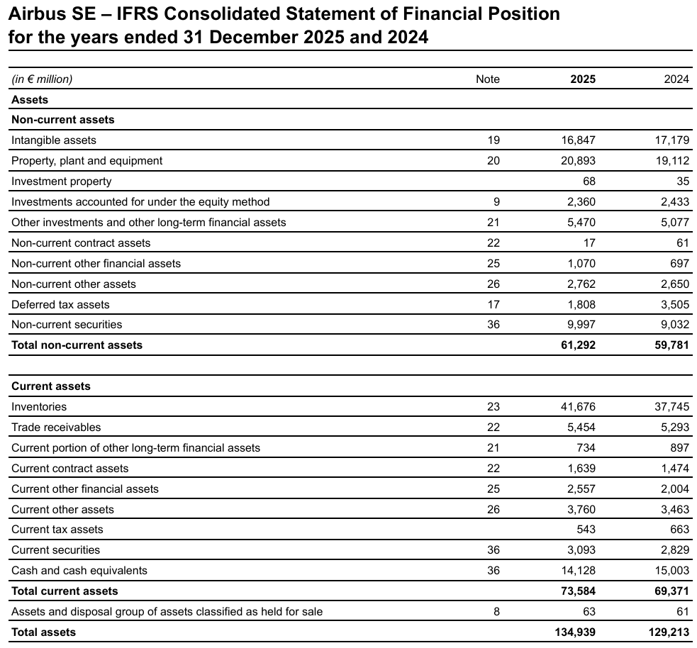
Airbus
Non-current assets (long-term assets)
+
Current assets (short-term assets)

Slide 23
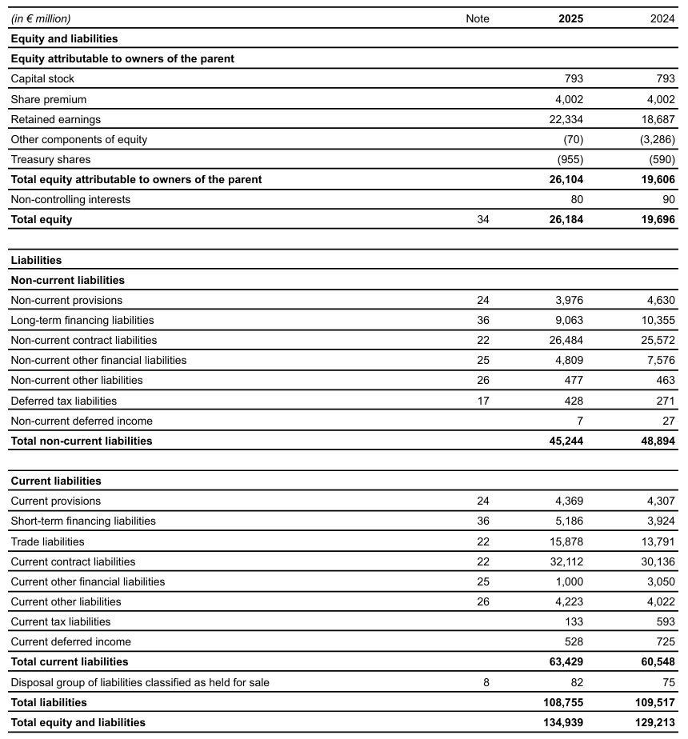
Airbus
Equity
+
Non-current liabilities
+
Current liabilities
=
Tota equity and liabilities = Total assets

Slide 24
Profit (i.e. change in equity) is not cash flow (i.e. change in assets)
Change in cash and cash equivalents
(= cash flow)
Change in assets
+
Change in noncash assets (= total assets excluding cash and cash equivalents)
=
=
Change in liabilities
Change in liabilities
+
+
Change in equity (excluding net income)
Change in equity
+
Net income (i.e. net profit or net (loss))

Slide 25
Example with provision: profit is not cash flow
Warranty: replacement of the product or repair of the product during 1 year
Expected percentage of products replaced: 2%
Expected percentage of products repaired: 5%
Unit manufacturing cost of this product: €100
Average repairment cost: €20
Selling price: €220
Unit commercial and administrative: €80 (without warranty)
Depreciation and amortization expense (included in manufacturing, commercial and adminstrative expenses): €30,000
In February 2026, 1,000 products were sold on credit (with one month credit term) what is the effect on the balance sheet at the end of February 2026?
All the cash expense is cash paid.

Slide 26
Provision for warranty Example: Microsoft

Slide 27
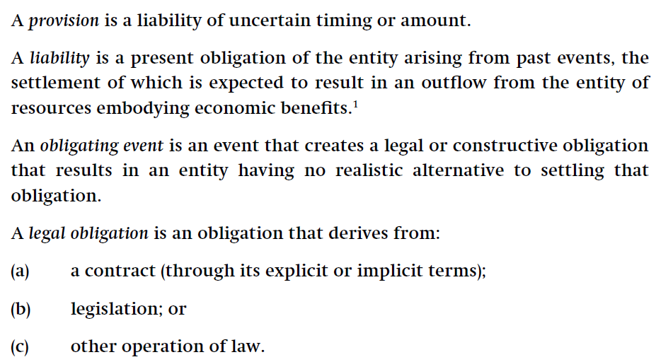
Under IFRS: IAS 37 Provisions, contingent liabilities and contingent assets

Slide 28
Income statement (or profit or loss account or P&L): revenue (and other income) - expense
Revenue (or sales or sales revenue or turnover)
Cost of sales (or cost of goods sold)
Gross profit (or gross margin)
Selling, general and administrative expense (without provision)
Provision expense (warranty)
Operating profit or EBIT (Earnings Before Interest and (income) Tax)
D&A expense is included in the cost of sales and the selling, general and administrative expense.

Slide 29
Income statement (or profit or loss account or P&L): revenue (and other income) - expense
Revenue (or sales or sales revenue or turnover) €220,000
1,000 x €220
Cost of sales (or cost of revenue or cost of goods sold) €100,000
1,000 x €100
Gross profit (or gross margin) €120,000
Selling, general and administrative (S,G&A) expense (without provision)
1,000 x €80 €80,000
Provision (or warranty) expense €3,000
2% x 1,000 x €100 + 5% x 1,000 x €20
Operating profit or EBIT (Earnings Before Interest and (income) Tax) €37,000
D&A expense are included in the cost of sales and the selling, general and administrative expense.

Slide 30
Impact on balance sheet (or statement of financial position)
Change in Current assets | Change in Non-current assets | Change in Current liabilities | Change in Non-current liabilities | Change in Equity

Slide 31
Impact on balance sheet (or statement of financial position)
Change in Current assets | Change in Non-current assets | Change in Current liabilities | Change in Non-current liabilities | Change in Equity
Cash and cash equivalents: Cash outflow = 100,000 + 80,000 – 30,000 = €(150,000) Accounts receivable : +€220,000 | P,P&E and intangible assets: D&A expense = €(30,000) | Provision (warranty) = +€3,000 |  | Profit: €37,000
Total assets: + €40,000 |  | Total liabilities: + €3,000 |  | Total Equity: + €37,000

Slide 32
Impact on balance sheet (or statement of financial position)
Change in Current assets | Change in Non-current assets | Change in Current liabilities | Change in Non-current liabilities | Change in Equity
Cash and cash equivalents: Cash outflow = 100,000 + 80,000 – 30,000 = €(150,000) Accounts receivable : +€220,000 | P,P&E and intangible assets: D&A expense = €(30,000) | Provision (warranty) = +€3,000 |  | Profit: €37,000 (= 220,000 (revenue) - 100,000 (cost of sales including D&A expense) - 80,000 (commercial and administrative expense including D&A expense and excluding provision) - 3,000 (Provision expense)
Total assets: + €40,000 |  | Total liabilities: + €3,000 |  | Total Equity: + €37,000

Slide 33
Profit is not cash flow
Profit €37,000
= 220,000 – 100,000 – 80, 000 – 3,000
D&A expense €30,000 (noncash expense)
Increase in working capital requirement (or operating working capital):
Increase in accounts receivable (assets) €(220,000)
Increase in provision (liabilities) €3,000
Operating cash flow €(150,000)
Change in Current assets | Change in Non-current assets | Change in Current liabilities | Change in Non-current liabilities | Change in Equity
Cash flow = €(150,000) Increase in Accounts receivable : €220,000 | Decrease in P,P&E and intangible assets: €(30,000) | Increase in Provision (warranty) = 3,000 |  | Profit: €37,000

Slide 34
Statement of cash flows and change in balance sheet
Balance sheet (BS) represented as an equation
Change in Assets (A)
=
Change in Liabilities (L)
+
Change in Equity (E)
Cash flow
Net income (P&L)
Net profit and change in cash can be reconciled and the statement of cash flows can be done with the change in balance sheet.
34

Slide 35
From net income to cash flow
Change in cash and cash equivalents
(= cash flow)
=
Net income (i.e. net profit or net (loss))
+
Change in equity (excluding net income)
+
Change in liabilities
-
Change in noncash assets (= total assets excluding cash and cash equivalents)

Slide 36
Example: net income > cash flow
Increase in liabilities: cash flow > Net income
Change in Assets (A)
=
Change in Liabilities (L)
+
Change in Equity (E)
Increase in Cash
Increase in liabilities
Net income (P&L)
=
+
For instance, some expenses are not paid during the period (.e. increase in accounts payable or accrued expenses).

Slide 37
Example: net income < cash flow
Increase in noncash assets: cash flow < Net income
Change in Assets (A)
=
Change in Liabilities (L)
+
Change in Equity (E)
Increase in noncash assets
Increase in Cash
+
Net income (P&L)
=
For instance, a portion of the revenue is not collected during the period (i.e. increase in accounts receivable).

Slide 38
Change in balance sheet: net income versus cash flow
Change in Assets (A)
=
Change in Liabilities (L)
+
Change in Equity (E)
Cash flow
Net income
Change in operating assets and nonoperating assets (excluding cash)
Change in operating liabilities
Change in debt (i.e. interest-bearing liabilities)
Change in contributed capital
- Dividends
38
Net income
= net profit or net loss

Slide 39
Exercise 1
What is the cash flow (with indirect method: change in balance sheet)?
Net profit | 200
Investment in P,P&E | 80
Increase in inventories | 10
Repayment of debt | 60
Issuance of shares | 110
Increase in accounts payable | 15

Slide 40
Exercise 1: answer
What is the cash flow (with indirect method: change in balance sheet)?
Net profit | 200
Investment in P,P&E | 80 | Increase in noncash assets
Increase in inventories | 10 | Increase in noncash assets
Repayment of debt | 60 | Decrease in debt
Issuance of shares | 110 | Increase in contributed capital
Increase in accounts payable | 15 | Increase in operating liabilities
Cash flow + Investment in P,P&E + Increase in inventories
= - Repayment of debt + Issuance of shares + Increase in accounts payable + Net profit

Slide 41
Exercise 1: answer
What is the cash flow (with indirect method: change in balance sheet)?
Net profit | 200
Investment in P,P&E | 80 | Increase in noncash assets
Increase in inventories | 10 | Increase in noncash assets
Repayment of debt | 60 | Decrease in debt
Issuance of shares | 110 | Increase in contributed capital
Increase in accounts payable | 15 | Increase in operating liabilities
Cash flow
= Net profit - Investment in P,P&E – Increase in inventories – Repayment of debt + Issuance of shares + Increase in accounts payable = 200 – 80 – 10 – 60 + 110 + 15 = 175

Slide 42
Exercise 1: answer
What is the cash flow (with indirect method: change in balance sheet)?
Other presentation of the calculation
Change in equity | 310 | Increase in equity
+ Change in liabilities | - 45 | Decrease in liabilities
- Change in noncash assets | - 90 | Increase in noncash assets
= change in cash (i.e. total cash flow) | 175 | Positive cash flow
Change in equity = Net profit + Issuance of shares: 200 + 110 = 310
Change in liabilities = Increase in accounts payable - Repayment of debt: 15 – 60 = - 45
Change in noncash assets = Increase in inventories + Investment in P,P&E: 10 + 80 = 90

Slide 43
Exercise 2
What is the cash flow (with indirect method: change in balance sheet)?
Net loss | 120
Depreciation and amortization expense | 25
Investment in intangible assets | 60
Decrease in inventories | 30
New debt | 60
Increase in accrued expenses | 50
Increase in accounts payable | 45

Slide 44
Exercise 2: answer
What is the cash flow (with indirect method: change in balance sheet)?
Net loss | 120
Depreciation and amortization expense | 25 | Decrease in noncash assets
Investment in intangible assets | 60 | Increase in noncash assets
Decrease in inventories | 30 | Decrease in noncash assets
New debt | 60 | Increase in debt
Increase in accrued expenses | 50 | Increase in operating liabilities
Increase in accounts payable | 45 | Increase in operating liabilities
Cash flow – D&A expense + Investment in intangible assets – Decrease in inventories
= Increase in accounts payable + Increase in accrued expenses + New debt + Net profit/(loss)

Slide 45
Exercise 2: answer
What is the cash flow (with indirect method: change in balance sheet)?
Net loss | 120
Depreciation and amortization expense | 25 | Decrease in noncash assets
Investment in intangible assets | 60 | Increase in noncash assets
Decrease in inventories | 30 | Decrease in noncash assets
New debt | 60 | Increase in debt
Increase in accrued expenses | 50 | Increase in operating liabilities
Increase in accounts payable | 45 | Increase in operating liabilities
Cash flow
= Increase in accounts payable + Increase in accrued expenses + New debt + Net profit/(loss)
+ D&A expense – Investment in intangible assets + Decrease in inventories
= 45 + 50 + 60 – 120 + 25 – 60 + 30 = 30

Slide 46
Exercise 2: answer
What is the cash flow (with indirect method: change in balance sheet)?
Other presentation of the calculation
Change in equity | - 120 | Decrease in equity
+ Change in liabilities | 155 | Increase in liabiliites
- Change in noncash assets | - 5 | Increase in noncash assets
= change in cash (i.e. total cash flow) | 30 | Positive cash flow
Change in equity = Net profit/(loss): -120
Change in liabilities = Increase in accounts payable + Increase in accrued expenses + New debt : 45 + 50 + 60 = 155
Change in noncash assets = – D&A expense + Investment in intangible assets – Decrease in inventories: -25 + 60 – 30 = 5

Slide 47
Transactions and impacts on balance sheet: examples

Slide 48
5 categories directly visible in the balance sheet
Balance sheet classification: 5 categories (CA + NCA = CL + NCL + E) impose to distinguish long-term and short-term
Assets (A)
=
Liabilities (L)
+
Equity (E)
Current Assets (CA)
Non-Current Assets (NCA)
Current Liabilities (CL)
Non-Current Liabilities (NCL)
In the balance sheet, short-term (or current) is less than one year and long-term (or non-current) is more than one year (if the operating cycle of the company lasts less than one year).

Slide 49
5 categories directly visible in the balance sheet
Balance sheet classification: 5 categories (CA + NCA = CL + NCL + E) impose to distinguish long-term and short-term
Assets (A)
=
Liabilities (L)
+
Equity (E)
Current Assets (CA)
Non-Current Assets (NCA)
Current Liabilities (CL)
Non-Current Liabilities (NCL)
Short-term
(less than 1 year)
Long-term
(more than 1 year)

Slide 50
What is the effect on the balance sheet of new long-term debt including a short-term portion?
Non-current assets (NCA) | Current assets (CA) | Equity |  | Non-current liabilities (NCL) | Current liabilities (CL)
 |  | Share capital and additional paid-in capital | Retained earnings and other reserves

Slide 51
What is the effect on the balance sheet of new long-term debt including a short-term portion?
Non-current assets (NCA) | Current assets (CA) | Equity |  | Non-current liabilities (NCL) | Current liabilities (CL)
 |  | Share capital and additional paid-in capital | Retained earnings and other reserves
 | Cash (increase) |  |  | Non-current portion of long-term debt (increase) | Current portion of long-term debt (increase)

Slide 52
What is the effect on the balance sheet of the repayment of a short-term debt?
Non-current assets (NCA) | Current assets (CA) | Equity |  | Non-current liabilities (NCL) | Current liabilities (CL)
 |  | Share capital and additional paid-in capital | Retained earnings and other reserves

Slide 53
What is the effect on the balance sheet of the repayment of a short-term debt?
Non-current assets (NCA) | Current assets (CA) | Equity |  | Non-current liabilities (NCL) | Current liabilities (CL)
 |  | Share capital and additional paid-in capital | Retained earnings and other reserves
 | Cash (decrease) |  |  |  | Short-term debt (decrease)
Net assets = Assets at net value – Liabilities = Equity

Slide 54
What is the effect on the balance sheet of the repayment of the short-term portion of a long-term debt with annual repayment?
Non-current assets (NCA) | Current assets (CA) | Equity |  | Non-current liabilities (NCL) | Current liabilities (CL)
 |  | Share capital and additional paid-in capital | Retained earnings and other reserves

Slide 55
What is the effect on the balance sheet of the repayment of the short-term portion of a long-term debt with annual repayment?
Non-current assets (NCA) | Current assets (CA) | Equity |  | Non-current liabilities (NCL) | Current liabilities (CL)
 |  | Share capital and additional paid-in capital | Retained earnings and other reserves
 | Cash (decrease) |  |  |  | Current portion of long-term debt (decrease)
 |  |  |  | Non-current portion of long-term debt (decrease) | Current portion of long-term debt (increase)

Slide 56
What is the effect on the balance sheet of the decision to distribute dividends in the coming months?
Non-current assets (NCA) | Current assets (CA) | Equity |  | Non-current liabilities (NCL) | Current liabilities (CL)
 |  | Share capital and additional paid-in capital | Retained earnings and other reserves
Pay-out ratio = Cash dividend / Net profit
Pay-out ratio is high: maturity stage
Pay-out ratio is low (or nil): growth (or accelerated) stage

Slide 57
What is the effect on the balance sheet of the decision to distribute dividends in the coming months?
Non-current assets (NCA) | Current assets (CA) | Equity |  | Non-current liabilities (NCL) | Current liabilities (CL)
 |  | Share capital and additional paid-in capital | Retained earnings and other reserves
 |  |  | Dividends to be distributed (decrease) |  | Dividends payable (increase)

Slide 58
What is the effect on the balance sheet of the payment of dividends due?
Non-current assets (NCA) | Current assets (CA) | Equity |  | Non-current liabilities (NCL) | Current liabilities (CL)
 |  | Share capital and additional paid-in capital | Retained earnings and other reserves

Slide 59
What is the effect on the balance sheet of the payment of dividends due?
Non-current assets (NCA) | Current assets (CA) | Equity |  | Non-current liabilities (NCL) | Current liabilities (CL)
 |  | Share capital and additional paid-in capital | Retained earnings and other reserves
 | Cash (decrease) |  |  |  | Dividends payable (decrease)

Slide 60
What is the effect on the balance sheet of the purchase of raw materials on credit?
Non-current assets (NCA) | Current assets (CA) | Equity |  | Non-current liabilities (NCL) | Current liabilities (CL)
 |  | Share capital and additional paid-in capital | Retained earnings and other reserves

Slide 61
What is the effect on the balance sheet of the purchase of raw materials on credit?
Non-current assets (NCA) | Current assets (CA) | Equity |  | Non-current liabilities (NCL) | Current liabilities (CL)
 |  | Share capital and additional paid-in capital | Retained earnings and other reserves
 | Raw material inventory (increase) |  |  |  | Accounts payable (increase)
Net assets = Assets at net value – Liabilities = Equity
Same effect on net assets: a cash purchase (increase in inventory and decrease in cash) or a credit purchase

Slide 62
What is the effect on the balance sheet of the purchase of property, plant and equipment (i.e. tangible fixed assets) on credit?
Non-current assets (NCA) | Current assets (CA) | Equity |  | Non-current liabilities (NCL) | Current liabilities (CL)
 |  | Share capital and additional paid-in capital | Retained earnings and other reserves

Slide 63
What is the effect on the balance sheet of the purchase of property, plant and equipment (i.e. tangible fixed assets) on short-term credit?
Non-current assets (NCA) | Current assets (CA) | Equity |  | Non-current liabilities (NCL) | Current liabilities (CL)
 |  | Share capital and additional paid-in capital | Retained earnings and other reserves
Property, Plant and Equipment (P,P&E) or tangible fixed assets (increase) |  |  |  |  | Accounts payable (suppliers of P,P&E) (increase)

Slide 64
What is the effect on the balance sheet of a research and development expenditure capitalized?
Non-current assets (NCA) | Current assets (CA) | Equity |  | Non-current liabilities (NCL) | Current liabilities (CL)
 |  | Share capital and additional paid-in capital | Retained earnings and other reserves

Slide 65
What is the effect on the balance sheet of a research and development expenditure capitalized (during the same period than the spending)?
Non-current assets (NCA) | Current assets (CA) | Equity |  | Non-current liabilities (NCL) | Current liabilities (CL)
 |  | Share capital and additional paid-in capital | Retained earnings and other reserves
Intangible (fixed) assets (increase) | Cash (decrease)
Matching principle: record expenses when they are related to revenue
Conservative principle: we prefer to have too much expenses than too much investments (i.e. amounts capitalized) (we are not sure about the effect of the expenditure on the long-term)
Expenditure in training, in marketing, in research = directly expense during the period (i.e. not capitalized)

Slide 66
What is the effect on the balance sheet of the amortization of an intangible (fixed) asset?
Non-current assets (NCA) | Current assets (CA) | Equity |  | Non-current liabilities (NCL) | Current liabilities (CL)
 |  | Share capital and additional paid-in capital | Retained earnings and other reserves

Slide 67
What is the effect on the balance sheet of the amortization of an intangible (fixed) asset?
Non-current assets (NCA) | Current assets (CA) | Equity |  | Non-current liabilities (NCL) | Current liabilities (CL)
 |  | Share capital and additional paid-in capital | Retained earnings and other reserves
Intangible (fixed) assets at net value (decrease) |  |  | Amortization expense (P&L) (decrease in retained earnings)
Intangible (fixed) assets at net value
= Intangible (fixed) assets at gross value (i.e. at cost) – Accumulated amortization and accumulated impairment losses (asset contra accounts)

Slide 68
What is the effect on the balance sheet of the depreciation of a tangible (fixed) asset?
Non-current assets (NCA) | Current assets (CA) | Equity |  | Non-current liabilities (NCL) | Current liabilities (CL)
 |  | Share capital and additional paid-in capital | Retained earnings and other reserves

Slide 69
What is the effect on the balance sheet of the depreciation of a tangible (fixed) asset?
Non-current assets (NCA) | Current assets (CA) | Equity |  | Non-current liabilities (NCL) | Current liabilities (CL)
 |  | Share capital and additional paid-in capital | Retained earnings and other reserves
Property, Plant and Equipment (P,P&E) (or tangible fixed assets) at net value (decrease) |  |  | Depreciation expense (P&L) (decrease in retained earnings)

Slide 70
What is the effect on the balance sheet of the depreciation of a tangible (fixed) asset?
Non-current assets (NCA) | Current assets (CA) | Equity |  | Non-current liabilities (NCL) | Current liabilities (CL)
 |  | Share capital and additional paid-in capital | Retained earnings and other reserves
Property, Plant and Equipment (P,P&E) (or tangible fixed assets) at net value (decrease) |  |  | Depreciation expense (P&L) (decrease in retained earnings)
Tangible (fixed) assets (or P,P&E) at net value
= Tangible (fixed) assets at gross value (i.e. at cost) – Accumulated depreciation and accumulated impairment losses (asset contra accounts)

Slide 71
What is the effect on the balance sheet of the recording of interest expense not already paid for a debt?
Non-current assets (NCA) | Current assets (CA) | Equity |  | Non-current liabilities (NCL) | Current liabilities (CL)
 |  | Share capital and additional paid-in capital | Retained earnings and other reserves

Slide 72
What is the effect on the balance sheet of the recording of interest expense not already paid for a debt?
Non-current assets (NCA) | Current assets (CA) | Equity |  | Non-current liabilities (NCL) | Current liabilities (CL)
 |  | Share capital and additional paid-in capital | Retained earnings and other reserves
 |  |  | Interest expense (decrease in retained earnings) |  | Accrued interest payable (increase)

Slide 73
What is the effect on the balance sheet of the payment of interest already due but not paid?
Non-current assets (NCA) | Current assets (CA) | Equity |  | Non-current liabilities (NCL) | Current liabilities (CL)
 |  | Share capital and additional paid-in capital | Retained earnings and other reserves

Slide 74
What is the effect on the balance sheet of the payment of interest already due not paid?
Non-current assets (NCA) | Current assets (CA) | Equity |  | Non-current liabilities (NCL) | Current liabilities (CL)
 |  | Share capital and additional paid-in capital | Retained earnings and other reserves
 | Cash (decrease) |  |  |  | Accrued interest payable (decrease)

Slide 75
What is the effect on the balance sheet of the payment of a quarterly subscription by a customer (used later)?
Non-current assets (NCA) | Current assets (CA) | Equity |  | Non-current liabilities (NCL) | Current liabilities (CL)
 |  | Share capital and additional paid-in capital | Retained earnings and other reserves

Slide 76
What is the effect on the balance sheet of the payment of a quarterly subscription by a customer (used later)?
Non-current assets (NCA) | Current assets (CA) | Equity |  | Non-current liabilities (NCL) | Current liabilities (CL)
 |  | Share capital and additional paid-in capital | Retained earnings and other reserves
 | Cash (increase) |  |  |  | Unearned (or deferred) revenue (increase)

Slide 77
What is the effect on the balance sheet of the usage of a quarterly subscription by a customer (already paid)?
Non-current assets (NCA) | Current assets (CA) | Equity |  | Non-current liabilities (NCL) | Current liabilities (CL)
 |  | Share capital and additional paid-in capital | Retained earnings and other reserves

Slide 78
What is the effect on the balance sheet of the usage of a quarterly subscription by a customer (already paid)?
Non-current assets (NCA) | Current assets (CA) | Equity |  | Non-current liabilities (NCL) | Current liabilities (CL)
 |  | Share capital and additional paid-in capital | Retained earnings and other reserves
 |  |  | Revenue (increase) |  | Unearned (or deferred) revenue (decrease)
Revenue = Revenue from sale of goods (recorded when the goods are delivered)
+ Revenue from sale of services (recorded when the service is rendered)

Slide 79
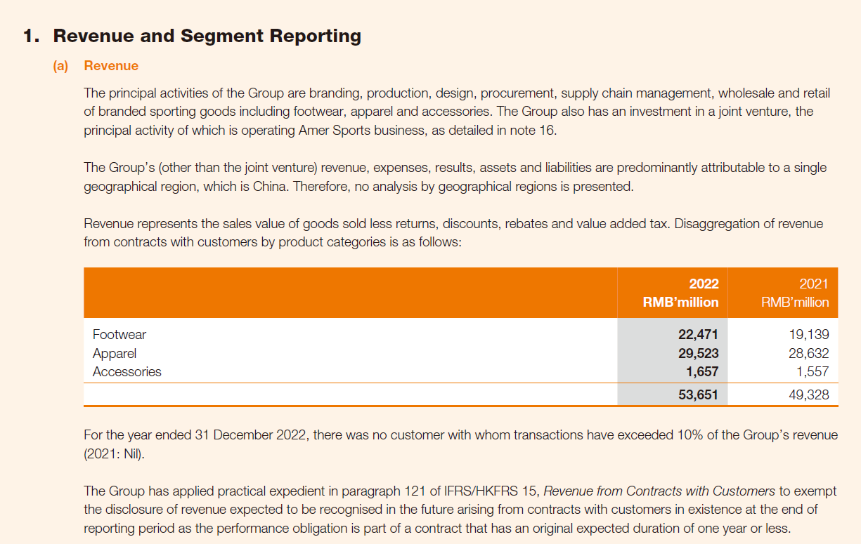
Revenue recognition
ANTA Sports, annual report 2022

Slide 80
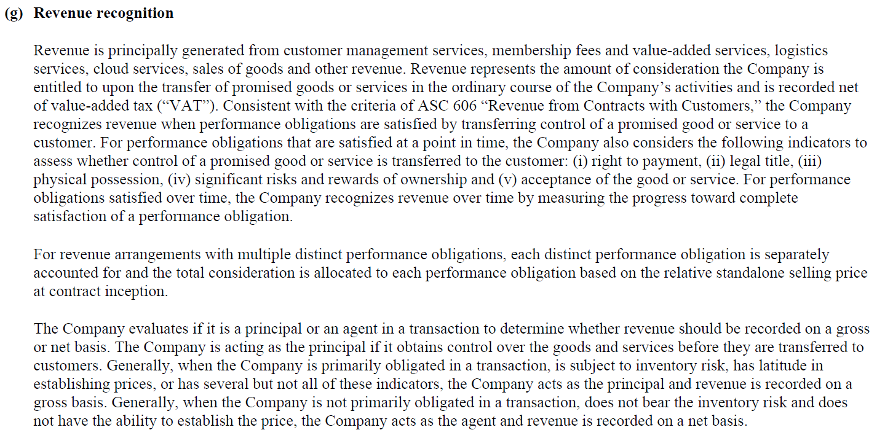
Revenue recognition
Alibaba, annual report 2025

Slide 81
Revenue recognition and balance sheet
A company is selling quarterly subscriptions for the access to a website.
This website provides financial information, financial analyses and valuation models of companies.
This company starts its activity at the beginning of February 2026 and sells 10,000 quarterly subscriptions at the beginning of February 2026 (and customers start to use these subscriptions at the beginning of February 2026).
The selling price of one quarterly subscription is €45.
What is the effect of these quarterly subscriptions on the balance sheet at the end of February 2026, at the end of March 2026 and at the end of April 2026?

Slide 82
What is the effect on the balance sheet quarterly subscriptions paid at the beginning and used for one month (Balance sheet as of February 28, 2026)?
Non-current assets (NCA) | Current assets (CA) | Equity |  | Non-current liabilities (NCL) | Current liabilities (CL)
 |  | Share capital and additional paid-in capital | Retained earnings and other reserves
Revenue = Revenue from sale of goods (recorded when the goods are delivered)
+ Revenue from sale of services (recorded when the service is rendered)

Slide 83
What is the effect on the balance sheet quarterly subscriptions paid at the beginning and used for one month (Balance sheet as of February 28, 2026)?
Non-current assets (NCA) | Current assets (CA) | Equity |  | Non-current liabilities (NCL) | Current liabilities (CL)
 |  | Share capital and additional paid-in capital | Retained earnings and other reserves
 | Cash: €450,000 |  | Revenue: 10,000 x 45 / 3 = €150,000 |  | Unearned (or deferred) revenue: 10,000 x 45 x 2/3 = €300,000

Slide 84
What is the effect on the balance sheet quarterly subscriptions paid at the beginning and used for two months (Balance sheet as of March 31, 2026)?
Non-current assets (NCA) | Current assets (CA) | Equity |  | Non-current liabilities (NCL) | Current liabilities (CL)
 |  | Share capital and additional paid-in capital | Retained earnings and other reserves
 | Cash: €450,000 |  | Revenue: 10,000 x 45 x (1/3 + 1/3) = €300,000 (revenue for 2 months) |  | Unearned (or deferred) revenue: 10,000 x 45 x (2/3 – 1/3) = €150,000

Slide 85
What is the effect on the balance sheet quarterly subscriptions paid at the beginning and used for two months (Balance sheet as of April 30, 2026)?
Non-current assets (NCA) | Current assets (CA) | Equity |  | Non-current liabilities (NCL) | Current liabilities (CL)
 |  | Share capital and additional paid-in capital | Retained earnings and other reserves
 | Cash: €450,000 |  | Revenue: 10,000 x 45 x (1/3 + 1/3 + 1/3) = €450,000 |  | Unearned (or deferred) revenue: 10,000 x 45 x (2/3 – 1/3 – 1/3) = €0

Slide 86
Working capital (i.e. current assets minus current liabilities)

Slide 87
Financial analysis: basic analysis
“Net” calculations are wanted for a macro analysis
Assets (A)
=
Liabilities (L)
+
Equity (E)
Current Assets (CA)
Current Liabilities (CL)
Working capital (WC)
–
=

Slide 88
Financial analysis: basic analysis
“Net” calculations are wanted for a macro analysis
Assets (A)
=
Liabilities (L)
+
Equity (E)
Current Assets (CA)
Current Liabilities (CL)
Working capital (WC)
–
=
In a small or medium enterprise (SME), working capital must be higher than zero (liquidity issue):
Does this company has the capacity to pay what is due in the short-term thanks to what it transforms or is already cash in the short-term? Yes if WC higher than zero.

Slide 89
MCQ n°1
Impact of a transaction on working capital (WC)
SOFT Enterprises sold products to customers on 1st February 2026 for a total price of RMB 90,000 paid 40% cash and 60% with a one-month credit term. The cost of the products was RMB 60,000. The most likely net change in SOFT’s working capital on 1st February 2026 related to this transaction is
1. RMB (60,000)
3. RMB 36,000
2. RMB 30,000
4. RMB 54,000
Between parenthesis means “minus”.

Slide 90
Answer
∆ Assets
=
∆ Liabilities
+
∆ Equity
∆ Current Assets (CA)
∆ Current Liabilities (CL)
∆ Working capital (WC)
+30,000
–
=
∆ Cash
+36,000
∆ Accounts receivable
+54,000
∆ Inventories
-60,000
∆ means “change in”

Slide 91
Answer
Assets (A)
=
Liabilities (L)
+
Equity (E)
Current Assets (CA)
Current Liabilities (CL)
Working capital (WC)
–
=
Before Inventory = RMB 60,000 WC = RMB 60,000
After Inventory = 0, Cash = RMB 36,000 WC = RMB 90,000
and Accounts receivable = RMB 54,000
Change
Increase in current assets by RMB 30,000 ∆ WC = + RMB 30,000

Slide 92
Balance sheet must be balanced
SOFT Enterprises sold products to customers on 1st February 2026 for a total price of RMB 90,000 paid 40% cash and 60% with a one-month credit term. The cost of the products was RMB 60,000. What are the impacts on assets, liabilities and equity of this transaction (i.e. sale of products) (at the date of the transaction)?

Slide 93
Profit = change in equity
∆ Assets
=
∆ Liabilities
+
∆ Equity
Profit (P&L)
Sales revenue RMB 90,000
Cost of goods sold RMB 60,000
Gross profit RMB 30,000
Cost of goods sold = outflow from finished goods inventory and merchandise inventory

Slide 94
Balance sheet must be balanced
∆ Assets +30,000
∆ Equity +30,000
∆ Assets
=
∆ Liabilities
+
∆ Equity
∆ Current Assets (CA)
P&L (or income statement)
Sales revenue RMB 90,000
Cost of goods sold RMB 60,000
Gross profit RMB 30,000
∆ Cash
+RMB 36,000
∆ Accounts receivable
+RMB 54,000
∆ Inventories
-RMB 60,000

Slide 95
Financial analysis: basic analysis
“Net” calculations are wanted!
Assets (A)
–
Liabilities (L)
=
Net Assets
=
Equity
Basic financial analysis can be done through the basic business equation (or balance sheet).

Slide 96
Financial analysis: basic analysis
“Net” calculations are wanted!
Assets (A)
–
Liabilities (L)
=
Net Assets
=
At net value
(means after all the reductions in value: accumulated depreciation, amortization, impairment losses, depletion, write-down, allowance for doubtful accounts)
Equity
Basic financial analysis can be done through the basic business equation (or balance sheet).

Slide 97
Working capital requirement (i.e. current operating assets minus current operating liabilities)

Slide 98
Financial analysis: basic analysis
Other categories in balance sheet:
Assets (A)
=
Liabilities (L)
+
Equity (E)
Cash
Operating Assets (OA)
(means related to operating activity)
Debt
Operating liabilities (OL)
(means related to operating activity)
Contribu-ted capital
(from shareholders)
Earned capital
(accumulated and retained net profits and accumulated OCI)
Other non-operating Assets
OCI: Other Comprehensive Income (not studied in this course)

Slide 99
Financial analysis: basic analysis
Other categories in balance sheet:
Assets (A)
=
Liabilities (L)
+
Equity (E)
Cash
Operating Assets (OA)
Debt
(means interest- bearing liabilities)
Operating liabilities (OL)
Contribu-ted capital
(from shareholders)
Earned capital
(accumulated and retained net profits and accumulated OCI)
Other non-operating Assets
(means in general interest-or-dividends- earning assets)
No interest-bearing liabilities

Slide 100
Financial analysis: basic analysis
“Net” calculations are wanted!
Assets (A)
=
Liabilities (L)
+
Equity (E)
Operating working capital or WC requirement (OWC or WCR)
or working capital from operations
or non-cash working capital
Current Operating Assets (OA)
Current Operating liabilities (OL)
–
=
Comment:
Under IFRS, accounts receivable and accounts payable are financial assets and financial liabilities but are operating assets and operating liabilities in this course and in financial analysis in general. The notion of “operating assets” and “operating liabilities” are not used under IFRS.

Slide 101
Financial analysis: example
Why the operating cash flow is different from profit?
Assets (A)
=
Liabilities (L)
+
Equity (E)
Cash
Operating Assets (OA) (means related to operating activity)
Operating liabilities (OL) (means related to operating activity)
Retained earnings
(accumulated Net Profits from P&L – accumulated Dividends)

Slide 102
MCQ n°2
Cash flow versus profit: working capital requirement (WCR) in the between
SOFT Enterprises starts its activity in January and earns (i.e. has a profit of) RMB 600,000 during this month thanks to the sale of 50,000 products at a selling price of RMB 100 and a unit cost (or expense) of RMB 88. 60% of expenses are cash paid and the rest is paid later. All the revenue from sale of products is collected in January (means represents a cash inflow). During this period, SOFT Entreprises increases its inventories by RMB 80,000 (which are cash paid). What is the operating cash flow in January?
1. RMB 280,000
3. RMB 2,280,000
2. RMB 520,000
4. RMB 2,360,000

Slide 103
MCQ n°2
Cash flow versus profit: working capital requirement (WCR) in the between
∆ Assets (A)
=
∆ Liabilities (L)
+
∆ Equity (E)
∆ Cash
∆ Operating Assets (OA)
∆ Inventories
∆ Operating liabilities (OL)
∆ Accounts payable
+ ∆ Accrued expenses
Net income
(is a change in equity)
∆ means “change in”

Slide 104
MCQ n°2
Cash flow versus profit: working capital requirement (WCR) in the between
∆ Assets (A)
=
∆ Liabilities (L)
+
∆ Equity (E)
∆ Cash
?
∆ Operating Assets (OA)
∆ Inventories
= + 80,000
∆ Operating liabilities (OL)
∆ Accounts payable
+ ∆ Accrued expenses
= 40% x 88 x 50,000
= 1,760,000
Net income
= 600,000

Slide 105
MCQ n°2
Cash flow versus profit: working capital requirement (WCR) in the between
∆ Assets (A)
=
∆ Liabilities (L)
+
∆ Equity (E)
∆ Cash
?
+
∆ Operating Assets (OA)
∆ Inventories
= + 80,000
=
∆ Operating liabilities (OL)
∆ Accounts payable
+ ∆ Accrued expenses
= 40% x 88 x 50,000
= + 1,760,000
+
Profit
= 600,000

Slide 106
MCQ n°2
Indirect method: operating cash flow calculated from net income
∆ Cash
2,280,000
=
Profit
600,000
∆ Operating liabilities (OL)
∆ Accounts payable
+ ∆ Accrued expenses
= + 1,760,000
∆ Operating Assets (OA)
∆ Inventories
= + 80,000
+
–
2,280,000 = 600,000 + 1,760,000 – 80,000

Slide 107
Indirect method: operating cash flow calculated from net income
Decrease in working capital requirement (WCR)
1,680,000
+
∆ Cash
2,280,000
Profit
600,000
∆ Current Operating liabilities (COL)
∆ Accounts payable
+ ∆ Accrued expenses
= + 1,760,000
–
∆ Current Operating Assets (COA)
∆ Inventories
= + 80,000
=
+
2,280,000 = 600,000 + 1,760,000 – 80,000

Slide 108
Indirect method: operating cash flow calculated from net income
Decrease in working capital requirement (WCR)
1,680,000
∆ Cash
2,280,000
=
Net income
600,000
+
Indirect method
∆ Cash
2,280,000
Profit
600,000
∆ Current Operating liabilities (COL)
∆ Accounts payable
+ ∆ Accrued expenses
= + 1,760,000
∆ Current Operating Assets (COA)
∆ Inventories
= + 80,000
=
+
–
2,280,000 = 600,000 + 1,760,000 – 80,000

Slide 109
MCQ n°2 Direct method
Cash inflow
5,000,000
Cash outflow
= 60% x 88 x 50,000 + 80,000 = 2,720,000
∆ Cash
2,280,000
=
–
= Operating cash flow (CFO: cash flow from operating activities)
2,280,000 = 5,000,000 – 2,720,000

Slide 110
Balance sheet categories: operating and nonoperating categories

Slide 111
Categories in the balance sheet relevant to financial analysis
Current assets |  | Non-current assets |  | Current liabilities |  | Non-current liabilities |  | Equity
CNOA | COA | NCNOA | NCOA | CD | COL | NCD | NCOL | Equity
Cash and cash equiva-lents Marketable securities | Accounts receivable Inventories Prepaid expenses | Investment in associates Other long-term financial assets Deferred tax assets | Property, plant and equipment Intangible assets | Short-term interest-bearing liabilities (=debt) | Accounts payable Accrued expenses Tax liabilities Unearned or deferred revenue | Long-term interest-bearing liabilities (=debt) (discounted) Provisions | Deferred tax liabilities
CNOA: Current non-operating assets NCNO: Non-current non-operating assets
COA: Current operating assets CD: Current debt NCD: Non-current debt

Slide 112
Vocabulary
Debt: also named financial liability, interest-bearing liabilities or nonoperating liabilities
Nonoperating assets: also named financial assets or interest-or-dividend-earning assets
Operating assets: assets used in operating activity (i.e. purchasing, producing and selling products and/or services)
Operating liabilities: cash saved in operating activity because operating expense are paid later (accounts payable, tax liabilities, social benefits liabilities, etc.) or revenue is collected in advance (unearned or deferred revenue)

Slide 113
Current assets |  | Non-current assets |  | Current liabilities |  | Non-current liabilities |  | Equity
CNOA | COA | NCNOA | NCOA | CD | COL | NCD | NCOL | Equity
Cash and cash equiva-lents Marketa-ble securities | Accounts receiva-ble Invento-ries Prepaid expenses | Invest-ment in associa-tes Other long-term financial assets | Property, plant and equipment Intangible assets Deferred tax assets | Short-term interest-bearing liabilities (=debt) | Accounts payable Accrued expenses Tax liabilities Unearned or deferred revenue | Long-term interest-bearing liabilities (=debt) (discount-ted) Provisions | Deferred tax liabilities
Interest and other financial income | Revenue and operating expenses | Financial income + Share of net profit from associa-tes | Sales revenue (or turnover) | Interest and other financial expense | Revenue and operating expenses | Interest expense | Revenue and operating expenses | Profit
Balance sheet and related effect on income statement

Slide 114
Working capital = Current assets – Current liabilities
Current assets |  | Non-current assets |  | Current liabilities |  | Non-current liabilities |  | Equity
CNOA | COA | NCNOA | NCOA | CD | COL | NCD | NCOL | Equity
Cash and cash equiva-lents Marketable securities | Accounts receivable Inventories Prepaid expenses | Investment in associates Other long-term financial assets Deferred tax assets | Property, plant and equipment Intangible assets | Short-term interest-bearing liabilities (=debt) | Accounts payable Accrued expenses Tax liabilities Unearned or deferred revenue | Long-term interest-bearing liabilities (=debt) (discounted) Provisions | Deferred tax liabilities

Slide 115
Working capital requirement = Current operating assets – current operating liabilities
Current assets |  | Non-current assets |  | Current liabilities |  | Non-current liabilities |  | Equity
CNOA | COA | NCNOA | NCOA | CD | COL | NCD | NCOL | Equity
Cash and cash equiva-lents Marketable securities | Accounts receivable Inventories Prepaid expenses | Investment in associates Other long-term financial assets Deferred tax assets | Property, plant and equipment Intangible assets | Short-term interest-bearing liabilities (=debt) | Accounts payable Accrued expenses Tax liabilities Unearned or deferred revenue | Long-term interest-bearing liabilities (=debt) (discounted) Provisions | Deferred tax liabilities

Slide 116
Net cash = current nonoperating assets – current debt
Current assets |  | Non-current assets |  | Current liabilities |  | Non-current liabilities |  | Equity
CNOA | COA | NCNOA | NCOA | CD | COL | NCD | NCOL | Equity
Cash and cash equiva-lents Marketable securities | Accounts receivable Inventories Prepaid expenses | Investment in associates Other long-term financial assets Deferred tax assets | Property, plant and equipment Intangible assets | Short-term interest-bearing liabilities (=debt) | Accounts payable Accrued expenses Tax liabilities Unearned or deferred revenue | Long-term interest-bearing liabilities (=debt) (discounted) Provisions | Deferred tax liabilities

Slide 117
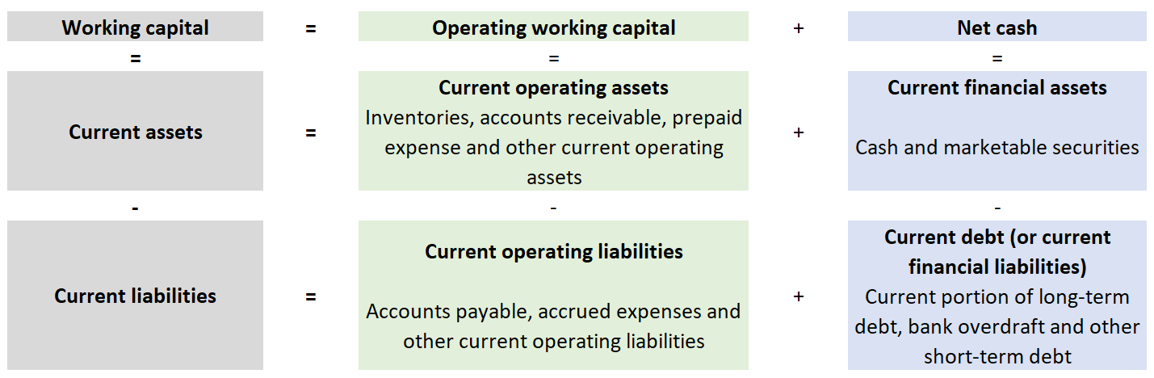
Working capital = Working capital requirement (or operating WC) + Net cash

Slide 118
Exercise session 2 Income statement or P&L and change in balance sheet
Raw material purchase: €120,000 (10,000 kg at €12/Kg)
Raw material used per product manufactured: 2kg
Production volume: 4,800 products
Sales volume: 4,000 products
Other manufacturing cost per product (excluding raw material): €80
Unit commercial and administrative expense: €70
Selling price per unit (excluding VAT): €200
No depreciation and amortization (D&A) expense
What is the operating profit?
40% of the revenue is on credit. 60% of the purchase and expense will be paid later (i.e. on credit).
What is the change in current assets, non-current assets, equity, current liabilities and non-current liabilites related to these transactions?

Slide 119
Exhibit: difference cash flow and profit
Impact of the change in operating working capital (or working capital requirement)

Slide 120
Example 1
We produce 100,000 products at a unit production cost of €20.
All the production cost is a cash expense (i.e. no depreciation and amortization expense).
We sell all the production at unit selling price of €30.
The customer will pay in one month.
What is the impact of the production and the sale of products on the balance sheet (BS)?

Slide 121
Financial analysis: example
Why the operating cash flow is different from profit?
-2,000,000 + 3,000,000
1,000,000
Assets (A)
=
Liabilities (L)
+
Equity (E)
Cash
-100,000 x €20
Operating Assets (OA) (means non-financial assets)
Accounts receivable :
+ 100,000 x €30
Operating liabilities (OL) (means non-financial liabilities)
Retained earnings
(accumulated Net Profits from P&L – accumulated Dividends)
P&L with production volume = sales volume
Sales revenue 100,000 x €30
Cost of goods sold (COGS) 100,000 x €20
Gross profit or gross margin 100,000 x €10

Slide 122
Example 1
We produce 100,000 products at a unit production cost of €20.
All the production cost is a cash expense (i.e. no depreciation and amortization expense).
We sell all the production at unit selling price of €30.
The customer will pay in one month.
What is the impact of the production and the sale of products on the working capital and working capital requirement (or operating working capital)?
Working capital = €1,000,000 = Equity + Non-current liabilities – Non-current assets = Current assets – Current liabilities = (-2,000,000 + 3,000,000) – 0 = 1,000,000
Working capital requirement = €3,000,000 (current operating assets: accounts receivable) – 0 (nothing in current operating liabilities)
WC – WC requirement = Net cash = - 2,000,000
Net cash = Cash + Marketable securities – current debt = -2,000,000 + 0 – 0

Slide 123
Example 2
We produce 120,000 products at a unit production cost of €20.
All the production cost is a cash expense (i.e. no depreciation and amortization expense).
We sell 100,000 products at unit selling price of €30.
The customer will pay in one month.
What is the impact of the production and the sale of products on the balance sheet (BS)?

Slide 124
Financial analysis: example
Why the operating cash flow is different from profit?
-2,400,000 + 3,000,000 + 400,000
1,000,000
Assets (A)
=
Liabilities (L)
+
Equity (E)
Cash
-120,000 x €20
Operating Assets (OA) (means non-financial assets)
Accounts receivable :
+ 100,000 x €30
Inventories :
+20,000 x €20
Operating liabilities (OL) (means non-financial liabilities)
Profit
1,000,000
Sales revenue 100,000 x €30
Cost of goods sold (COGS) 100,000 x €20
Gross profit or gross margin 100,000 x €10
P&L with production volume higher than sales volume

Slide 125
Example 2
We produce 120,000 product at a unit production cost of €20.
All the production cost is a cash expense (i.e. no depreciation and amortization expense).
We sell 100,000 products at unit selling price of €30.
The customer will pay in one month.
What is the impact of the production and the sale of products on the working capital and working capital requirement (or operating working capital)?
Working capital = €1,000,000 = Equity + Non-current liabilities – Non-current assets
Or Working capital = Current assets – Current liabilities = -2,400,000 + 3,000,000 + 400,000 – 0 = €1,000,000
Working capital requirement = €3,400,000
WC – WC requirement = 1,000,000 – 3,400,000 = Net cash = €(2,400,000)

